Slide 1
Group 10 Modeling Suicide Rates at the Country Level
Monal Garg (mgarg@sas), Amit Gupta (akgupta@seas), Aashish Jain (aashj99@seas), Moksh Jawa (moksh@seas)
Mentor: Jane Lee (janehlee@seas)
CIS 520
April 30, 2019

Slide 2
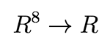
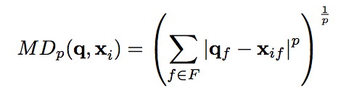
Inputs:
Youth Unemployment, Alcohol Consumption, Life Expectancy, Country Population, Fertility Rate
Output:
Number of Suicides per 100k population (in a year)
Model:
Regression Problem -
Countries too distinct for Nearest Neighbor to be effective
Nearest Neighbors
Euclidean Distance
Minkowski Distance
k = [1, 2, 5, 10]
q = [1, 2, 3]
Best Method:
k = 1, q = 2
1-NN with Euclidean
Regression
Least Squares
Unregularized
L₂ Regularized
Linear
Unregularized
L₂ Regularized
λ = [10⁻³, 10⁻², 10⁻¹, 1, 10, 100, 500, 1000]
Best Method:
λ = 10⁻²
Linear, L₂ Regularization
Neural Network
ReLU
Sigmoid
# Iterations = 20000
Learning Rate = 0.01
1 Hidden Layer
Hidden Layer Size = [1, 5, 10, 15, 25, 50]
Best Method:
Sigmoid Loss Function
Hidden Layer with X Nodes

